Slide 1
10333
Mohammad Hamdy - Sadek Mohamed - Ahmed Essam

Slide 2
Grand Challenges
Caused
Industrial Base issues
Climate change
Pollution

Slide 3
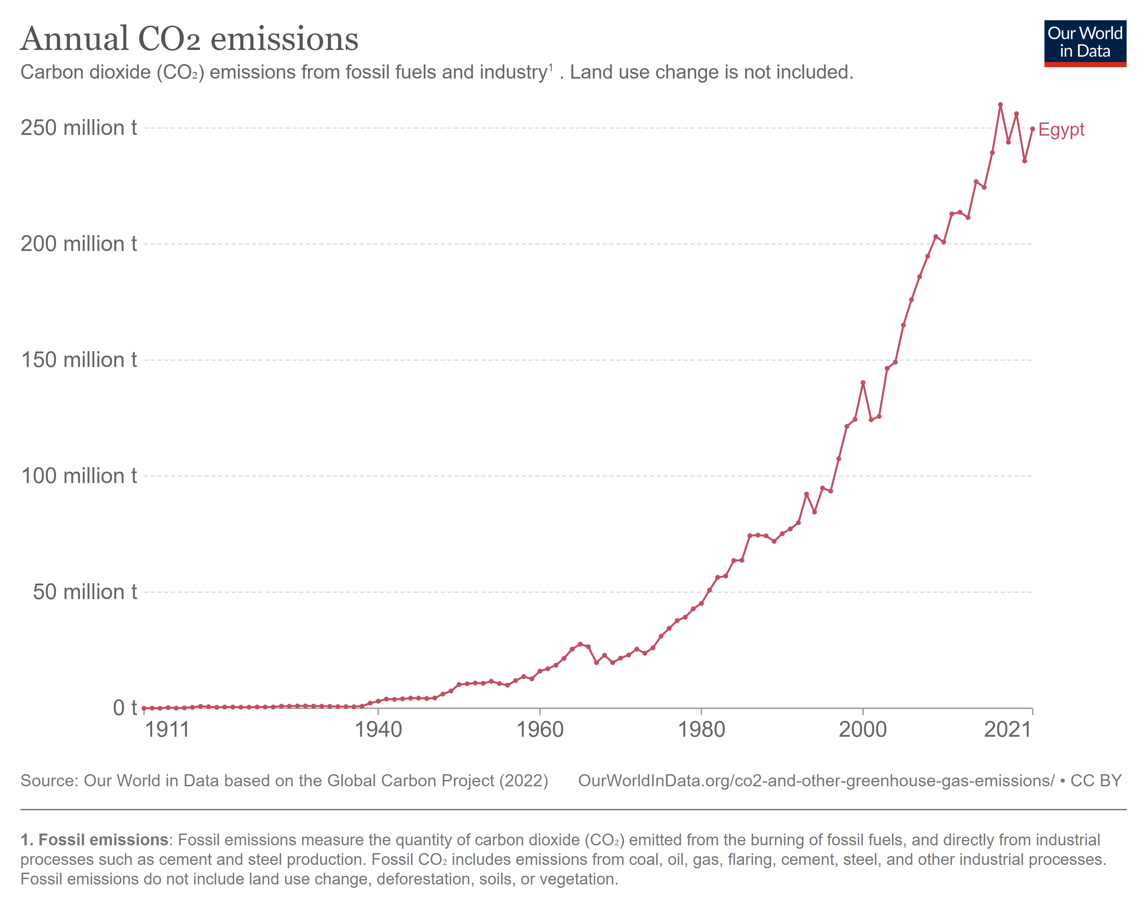

Slide 4
Causes
Arid Areas
Climate change
Sea Level Rise

Slide 5
Problem to be solved
Mitigation of climate change
In coastal regions
Internet of things

Slide 6
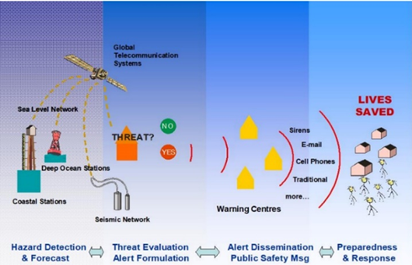
IOTWMS
Mechanism
Mission
Strength
Extensive database
Predicting future tsunamis along indian coastline through IoT
Prerequisites
Data from worldwide organizations.
Weakness

Slide 7
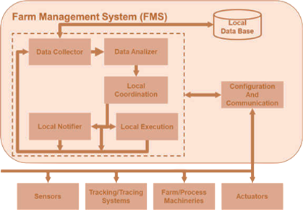
Agro 4.0
Mechanism
Strength
Weakness
Increase crop yield
Signal interference
Expensive

Slide 8
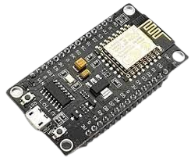
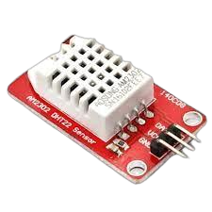
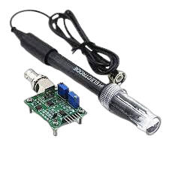
Materials
ESP 8266
Temperature sensor DHT-22
pH sensor

Slide 9
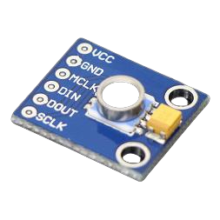
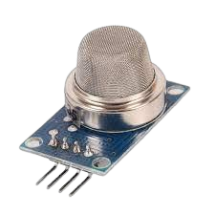
Water level Sensor
Air quality sensor MQ 135
Firebase

Slide 10
HTML, CSS & Java Script

Slide 11
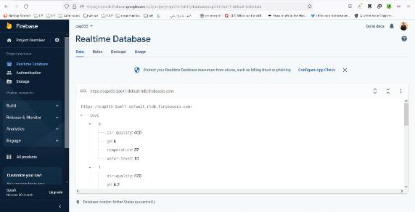
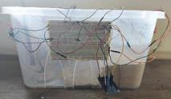
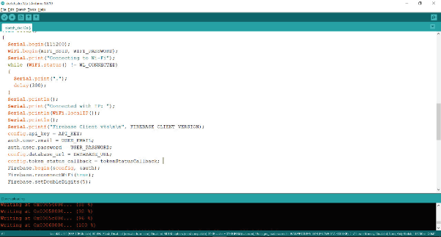
Methods
Creation of database by using Google firebase
Connection of Sensors to ESP
Arduino Codes of ESP Database
Connection

Slide 12
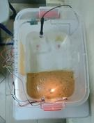
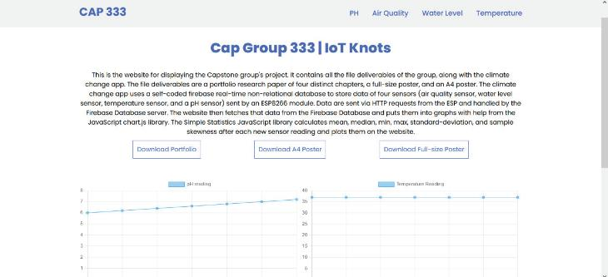
A model simulating climate change at mediterranean coastal areas
Graphical user interface was improved by adding fetched JSON.

Slide 13
Percent Accuracy
Design Requirements
Dynamic Range

Slide 14
Test Plan
Percent Accuracy
Dynamic Range
4 pH
20cm
23ºC
Port Said
$$100 −(\frac{\left|V_{R} − V_{O}\right|}{V_{R}} ×100)$$
Maximum - Minimum

Slide 15
Negative results
Free Hosting services (inifinityfree.net) do not tolerate HTTP requests from non-browsers
Using Firebase as a free solution for small projects that doesn’t require coding a full API.
They do not provide the ability to host both Mysql & Nodejs .

Slide 16
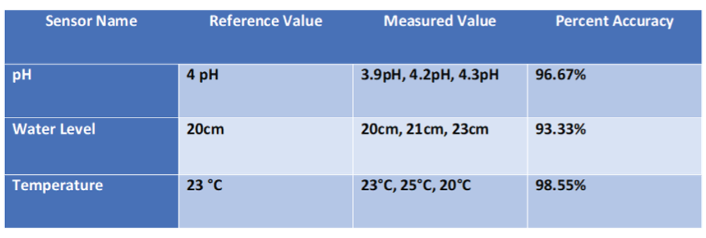
Positive results
$$100 −(\frac{\left|V_{R} − V_{O}\right|}{V_{R}} ×100)$$
Percent Accuracy

Slide 17
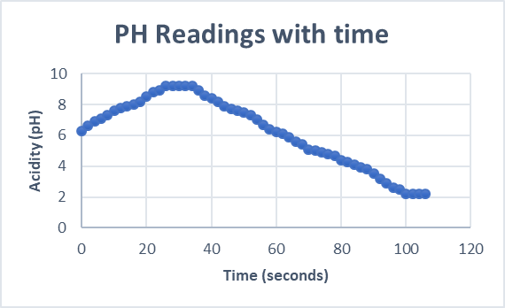
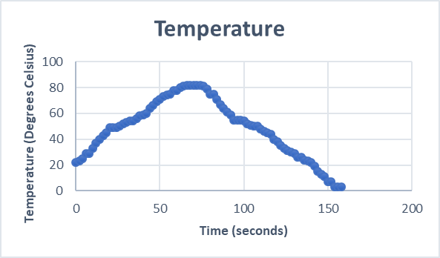
Temperature range 3-82 °C
pH range 2.2-9.2
Port Said

Slide 18
Analysis

Slide 19
Co2 acidifies seawater.
Intermediate products
Final Product
Reactants
Carbon dioxide and water
Carbonic acid
Bicarbonate Ions

Slide 20
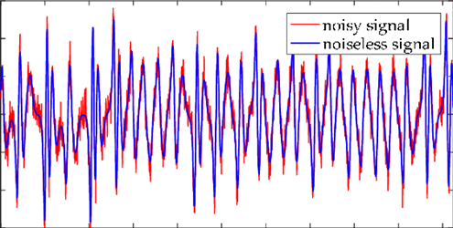
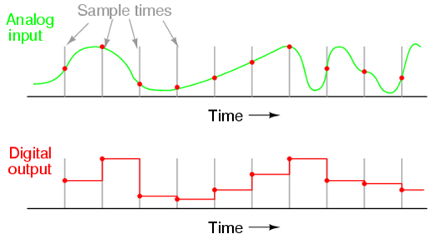
Effect of noise on signals
Analog to digital conversion

Slide 21
Analog To Digital Converter

Slide 22
Coverage range of antenna

Slide 23
Dataflow

Slide 24
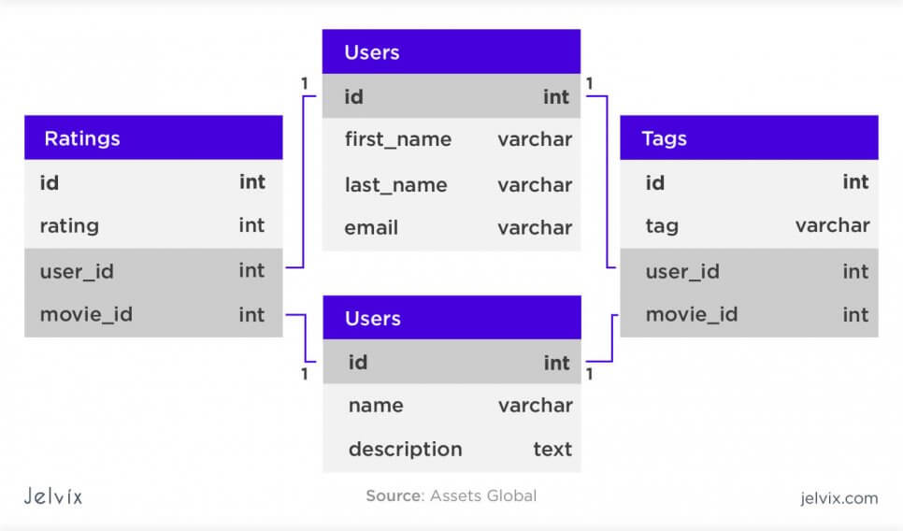
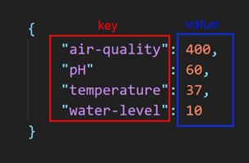
Relational Database
Non-Relational Database

Slide 25
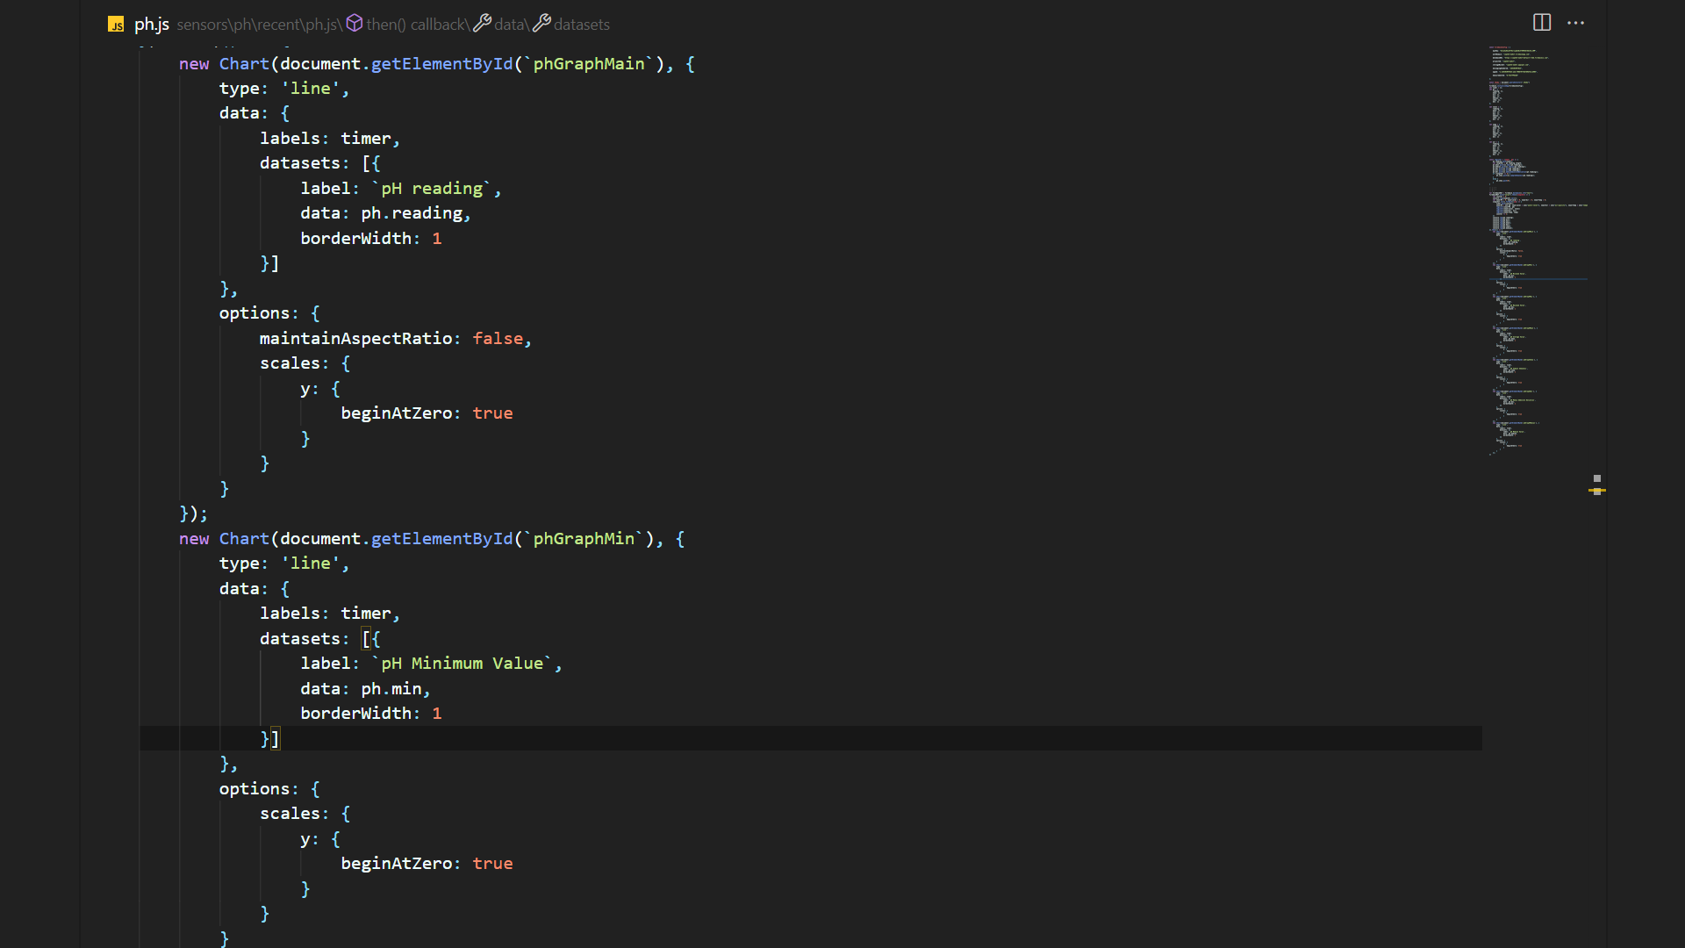
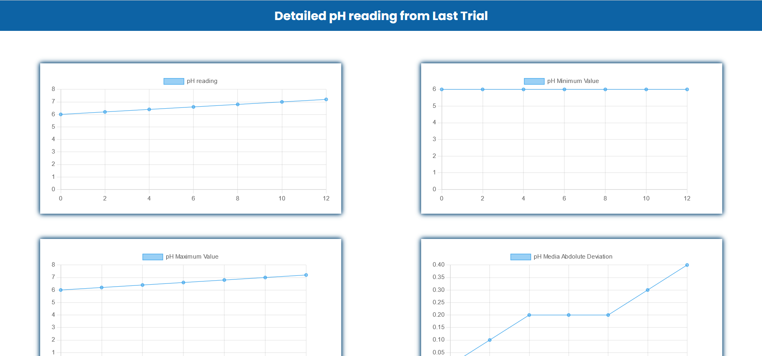
JS Code that controls HTML & CSS
➔
Output of Chart.js library + HTML & CSS

Slide 26
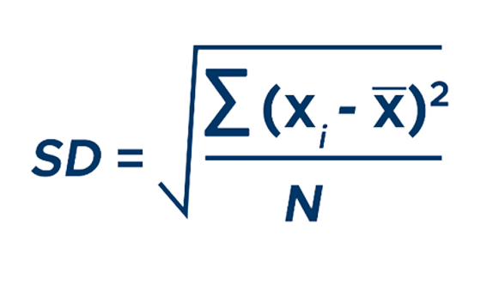
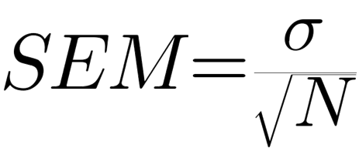
Standard deviation
Standard error of the mean

Slide 27
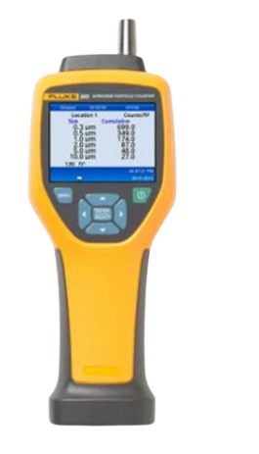
Recommendations
Fluke 985 particle counter
MySQL open-source database

Slide 28
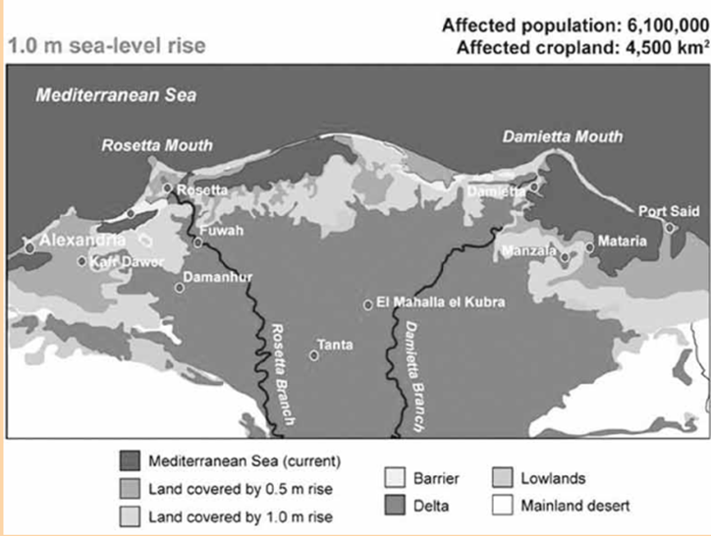
Real-life application
Low Land Elevation
High Rates of Land Subsidence
Estimated effects of sea level rise on Port said

Slide 29
THANKS!

