Slide 1
Slope Desalinator
Group 207, sTEM high school for boys – 6th of October, 2021-2022
YUSUF YASSER – SADEK MOHAMMED – WALID MEDHAT

Slide 2
Introduction

Slide 3
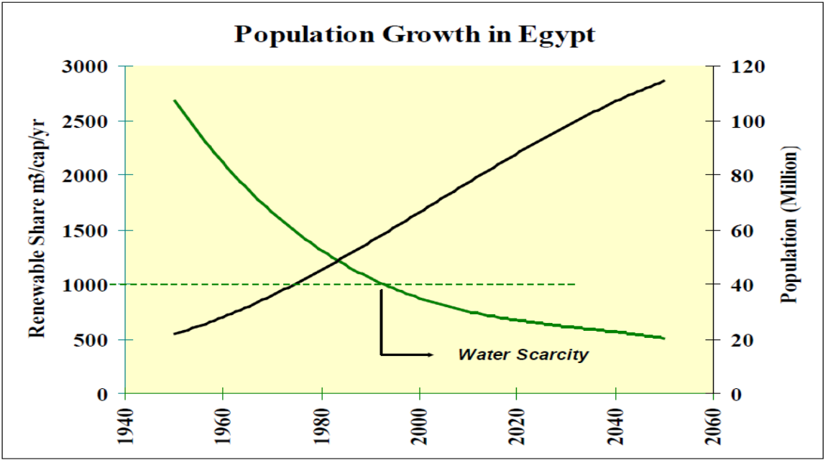
Population growth in Egypt three times in 60 years.
Per capita water share decreased from 2500m³ to 700m³
Demand of clean water resources increased dramatically

Slide 4
Exhausted utilized Egypt water resources
Made the study
Take the path of improving the underutilized water resources

Slide 5
Agriculture uses 80-85% of water use in Egypt.
Seawater is highly available
A project that makes seawater utilized for agricultural use

Slide 6
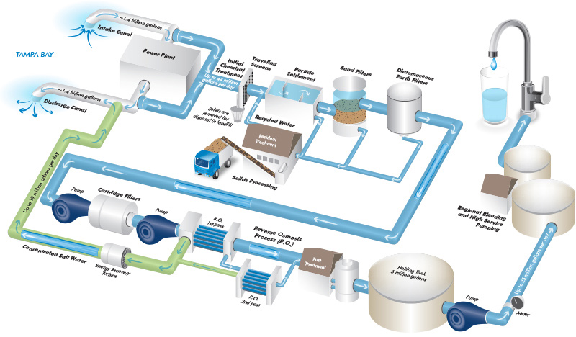
Tampa Bay Water Desalination project
High production rate in comparison to other solutions
The project is highly expensive.

Slide 7
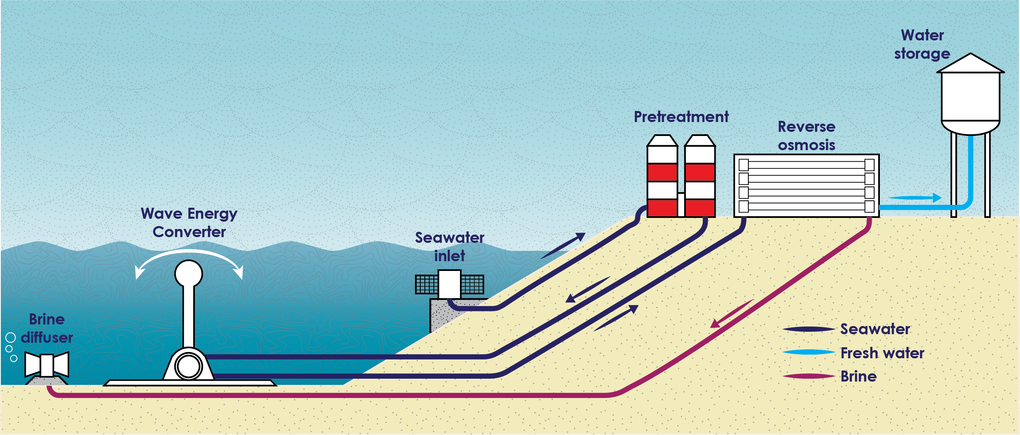
Wave-powered water desalination project in Greenland, Australia.
A green, eco-friendly project.
Waves are not that available.

Slide 8
Solution:
Eco-friendly, effectiveness, and efficiency
Water Quality Parameters: pH: 6.5-7.5 and TDS: 400-700 mg/L
Prototype:
High output-to-input ratio: more than 80%.

Slide 9
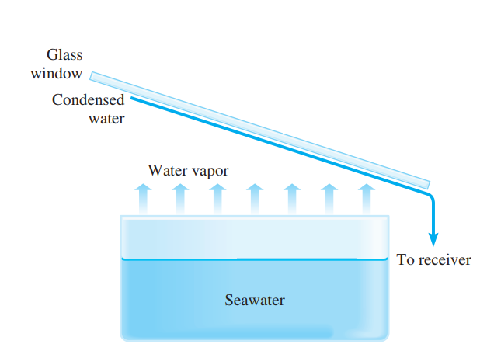
A glass container
Evaporates
Condensates
Mineralizes

Slide 10
Materials & Methods

Slide 11
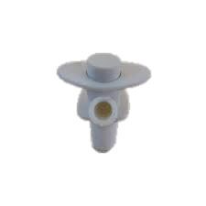
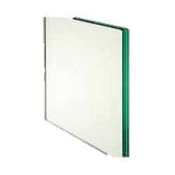
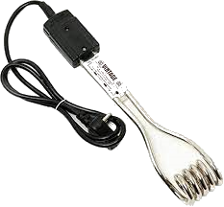
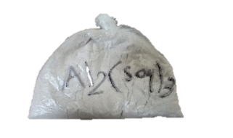
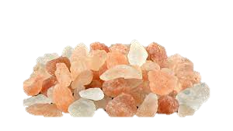
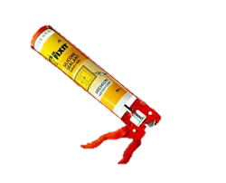
Standard 6mm Glass
Immersion coil heater
Water Press Tap
Aluminum Sulphate
Himalayan (Pink) salt
Silicone Sealant

Slide 12
1.
2.
Quantity
Shape
Dimensions (m)
Area (m²)
3D dimension design
2
Trapezoid
0.62, 0.64, 0.17, 0.45
0.1775
2
Rectangle
0.17, 0.2
0.034
Through sketchup
1
Rectangle
0.62, 0.2
0.124
2
Rectangle
0.08, 0.43
0.0344
1
Rectangle
0.66, 0.19
0.1254

Slide 13
3.
4.
5.
The 8 faces were sealed
Output vents were made
Two 0.08*0.43 faces were above the holes
The holes were filled
Decrease the temperature and pressure difference
To condensate the vapor

Slide 14
6.
7.
8.
Heater was isolated by silicone
Roof
Press tap was put into the container
Put to heat water
Condense the water and direct it
Allow the water to get out of the container

Slide 15
9.
Test Plan
1 liter to do the test plan.
Initial volume (5.6) liters added
(20-30) mg of aluminum sulphate were added, left for 45
Decrease the boiling point of water
Prototype was operated and heater opened till the 5.6L mark
Open video
Cool the heater and cause no harm
After condensation, to mineralize
Pink salt was added for mineralization in collection tank

Slide 16
Results

Slide 17
Cracks
Caused by
Difference in temperature &pressure
Solved by
Making holes that decrease the difference

Slide 18
Authorized here
Positive Results
Measurable quantity | pH | TDS | Loss rate | Time
Seawater | 7.80±0.01 | 10000±10 | - | -
Before Mineralization | 7.10±0.01 | 56±10 | 12% | 29
After Mineralization | 6.94±0.01 | 579±10 | - | -

Slide 19
Analysis

Slide 20
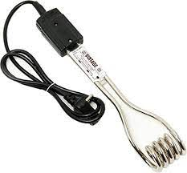
Immersion Coil Heater
3rd PHY LO
Resistive (Joule) Heating.
Flow electricity through resistance gives heat
Calculated in terms of power
$$V×I$$
$$I^{2}×R$$
Copper is a great candidate
Has a high conductivity

Slide 21
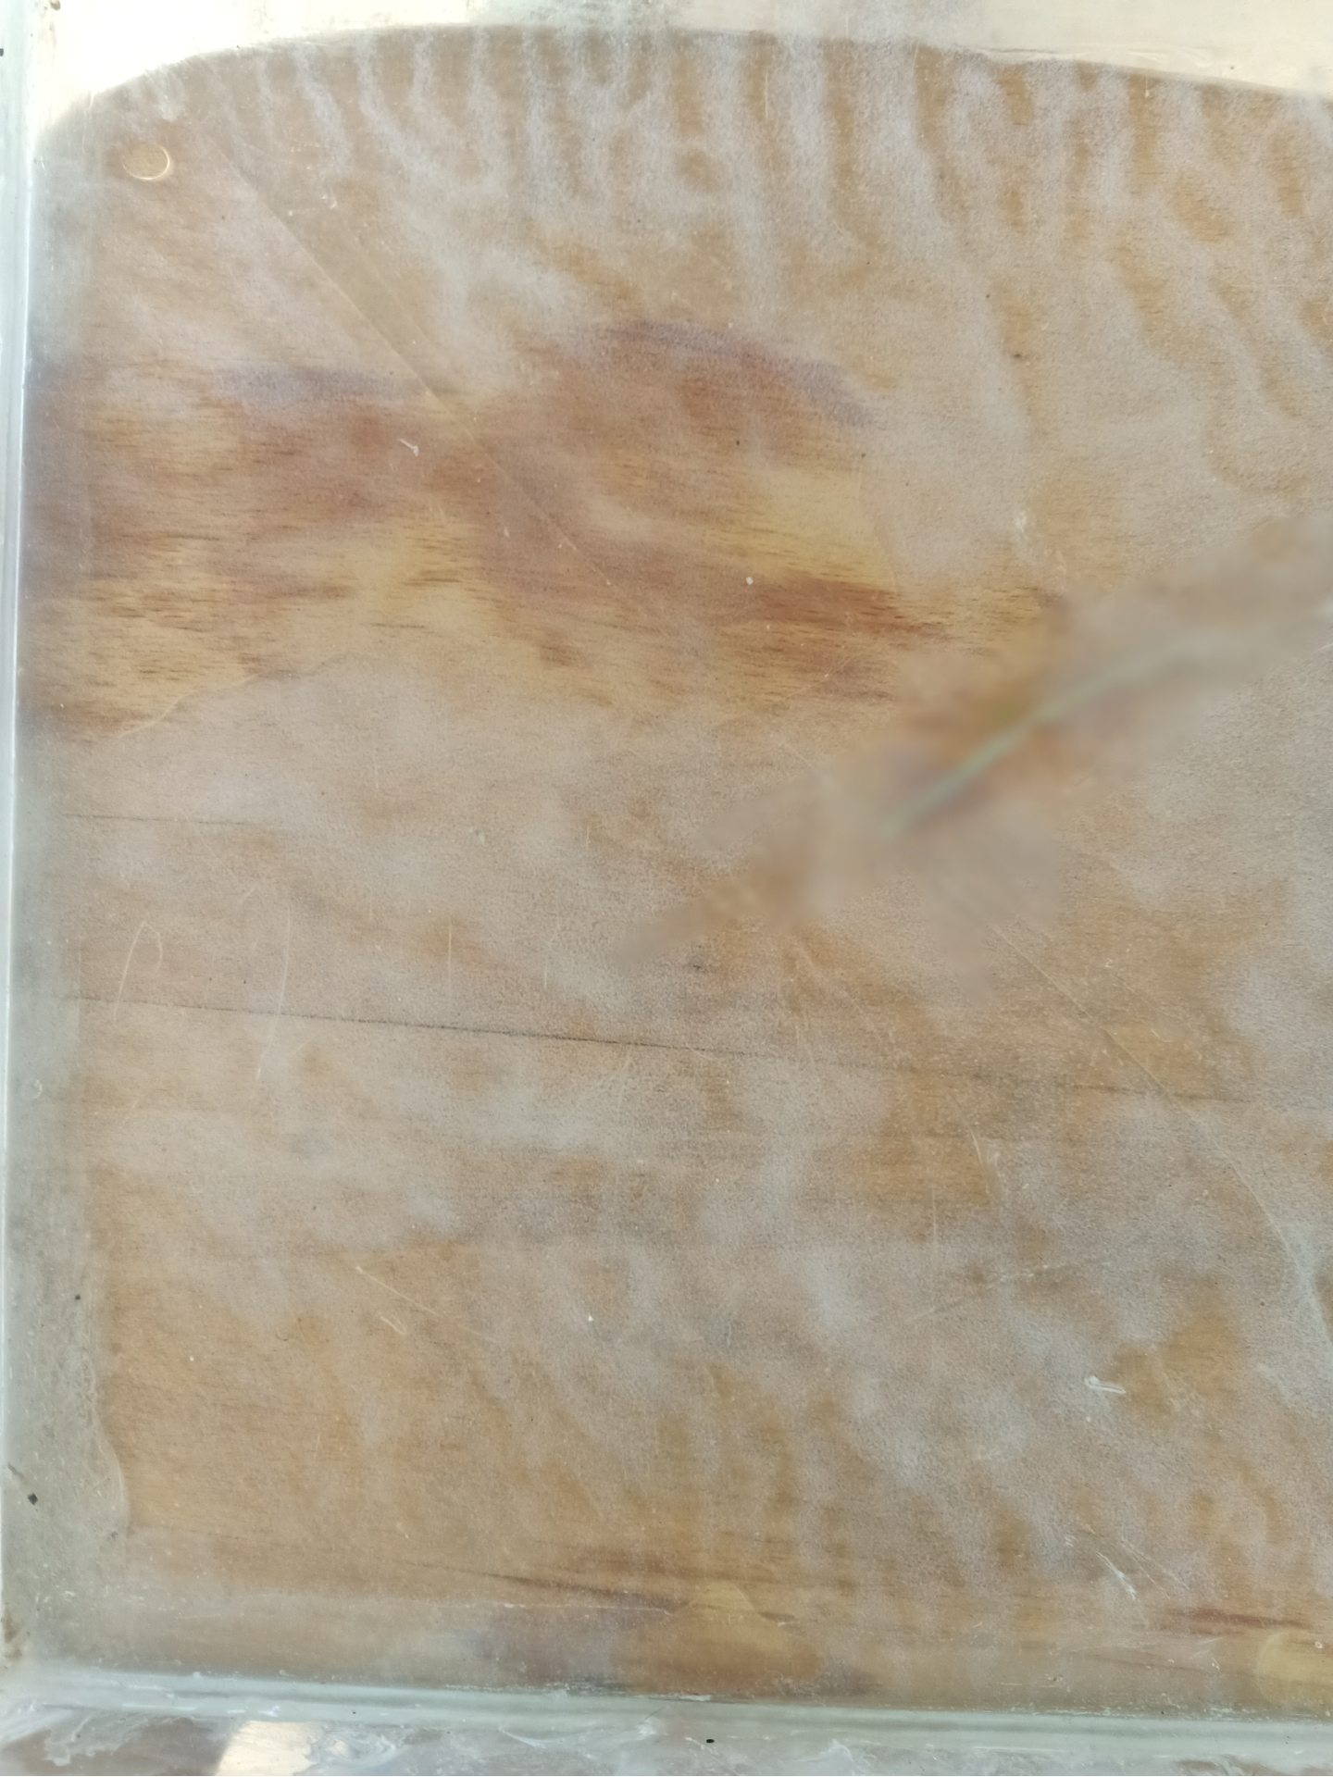
2nd Chem LO
Aluminum Sulphate and Boiling Point Elevation
During the process of filtration
Large Particles settle out quickly
Small particles settle out slowly and may not settle
Al₂(SO₄)₃
Reacts with the small precipitates and forms large precipitates that settle out quickly.
The Purpose
Decreasing the boiling point through decreasing solutes in solution
$$∆T_{b}=K_{b} . m_{solution}$$

Slide 22
Heat Energy
Heat Energy
Energy that changes temperature.
Calculated by
m: mass in grams
ms$dθ$
s: specific heat constant for each material, water is 1$℃^{−1}g^{−1}∁$
528000∁ =2209152J
Difference in temperature (final – initial)
24.5 minutes to heat water
Heater’s power is 1.5KW

Slide 23
Thermal Expansion
Area Thermal Expansion
Defined as
Equation
Prototype
Change in area
$$∆A= γA_{0}∆T$$
Expansion led to some cracks in the prototype
$∆A$ is the change in area
Because of
$γ$is the coefficient of expansion
(18 x 10⁻⁶ in case of glass)
was solved by
Motion of molecules due to heat
$∆T$ is the change in temperature
Adding holes
to
Each face would increase by factor of 1.44x10⁻³
decrease the temperature difference

Slide 24
Inert substance that does not react with water
The best available choice for health
Glass
Relatively Low coefficient of expansion (9 x 10⁻⁶)
Handle high temperatures under some adjustements

Slide 25
Water moves on the roof of the prototype due to Cohesion and Adhesion.
Cohesion
Adhesion
1st GEO LO
Attraction between water molecules and each other
Attraction between water molecules and other substances
Water droplets move down as a whole grabbing each other
Water droplets move down without falling away from the roof

Slide 26
1st & 3rd Chem LO
Water Quality Parameters
TDS
pH
Measure of total dissolved solids
Measure of the acidity or basicity of water
Using a TDS meter
Using a pH meter
Makes use of electrical conductivity
Difference in H⁺ percentage
Acidic
Neutral
Basic
pH scale
<7
=7
>7

Slide 27
Recommendation

Slide 28
Recommendation
Real-life Application
Location
Cultivating 100 square meters of oranges (which are suitable for our water quality measurements)
Mediterranean sea
Because
According to calculations, 63 Liters should be generated per hour.
Red Sea is one of the saltiest seas in the world
Since the project produces 1.76L each hour, the project should be generated 35.8 times.
41 ppm

Slide 29
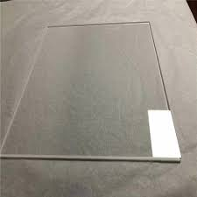
Pyrex Glass (borosilicate glass)
Used Glass (Standard 6mm glass)
3 x 10⁻⁶
9 x 10⁻⁶
Lower expansion and damage
Higher expansion and damage
Trace Minerals Drops
Himalayan Salt
More Minerals Percentage
Less Minerals Percentage
Less NaCl
More NaCl

Slide 30
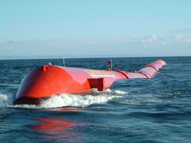
Wave Electricity
P = $\frac{ρg^{2}}{64π}{H_{m0}}^{2}T_{e}$, where P = wave energy flux per unit of wave-crest length, H_{m0}= the significant wave height, T_{e}= the wave energy period, $ρ$ = water density, and g= the acceleration by gravity.
Average wave height in Mediterranean sea
0.75m
If
Period = 3sec
If the rate was constant
23214.24 KW / day

