Slide 1
Gentian Blossom Group 209

Slide 2
Some Challenges of the project
Green energy
Industrial base

Slide 3
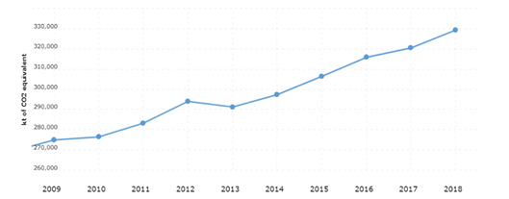

Slide 4
Our Problem is
Improve a traditional industrial process.
Using a Feedback Control Mechanism
Solved through
Using a green energy source

Slide 5
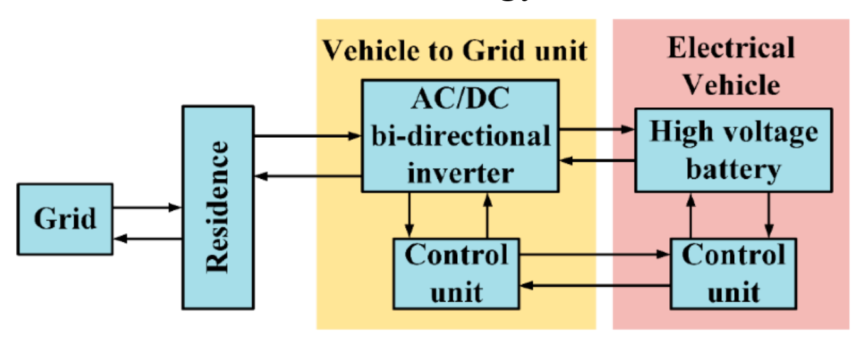
Smart Grids Solar Energy Production Project
Monitors Electricity for home appliances
Name
Usage
Strengths
Efficient
Weakness
Expensive

Slide 6
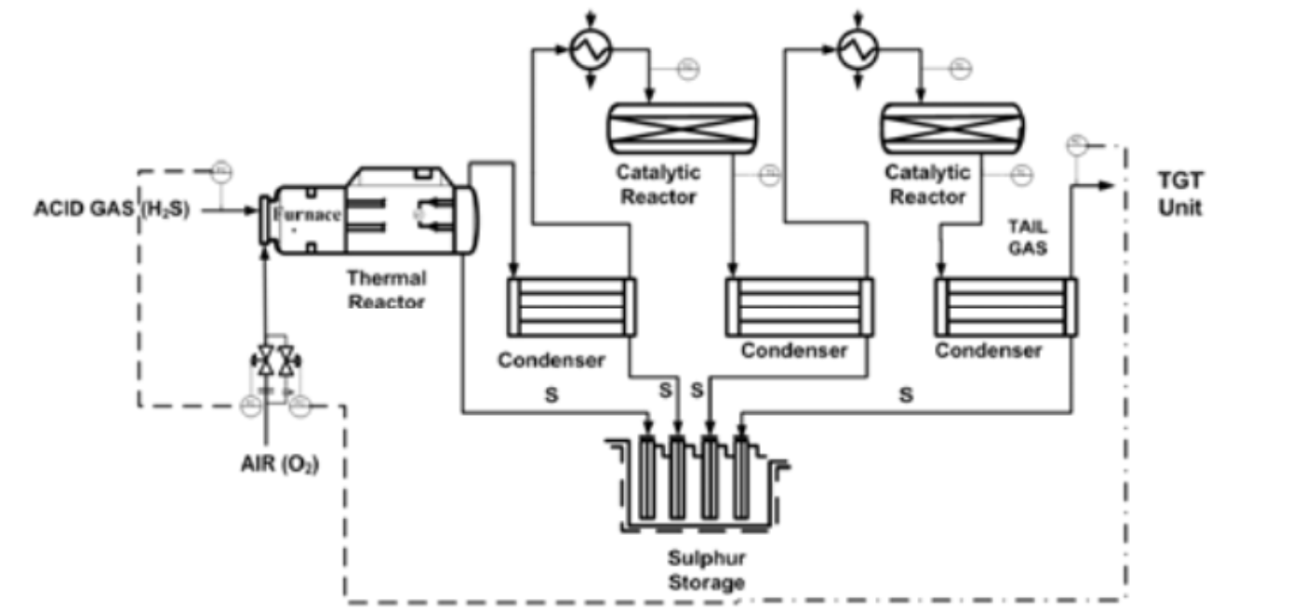
Sulfur Recovery unit
Name
Usage
Extracts Sulphur from acid gases
Strengths
Automated
Difficulty in installation
Weakness

Slide 7
The solution is:
Improving the Gentian Violet Solution Industry.
Usage
Anti-Microbial
&
Dyes
&
Ink
&
Gram Staining
Time inefficient
Feedback Control Mechanism
&
Solar Energy as a power source

Slide 8
Design Requirements
Ideal pH of 3.4
Efficiency: Time

Slide 9
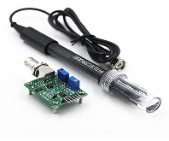
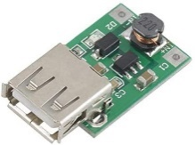
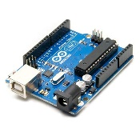
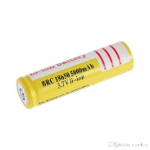
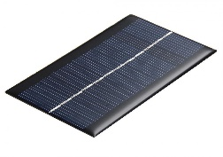
Materials
Gentian Violet Powder
Arduino UNO pH sensor
Step-up Transformer
3.7 Volt, 5.5 Ampere Lithium ion Battery
Arduino UNO Board
Solar Panel

Slide 10
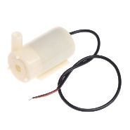
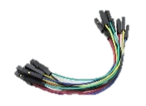
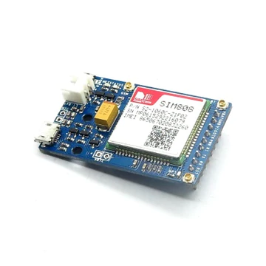
3-5 Volt Water Pump
Male-Male & Male-Female Jumpers
Self-stirring mug
Hose
Li-ion Battery Charger Module

Slide 11
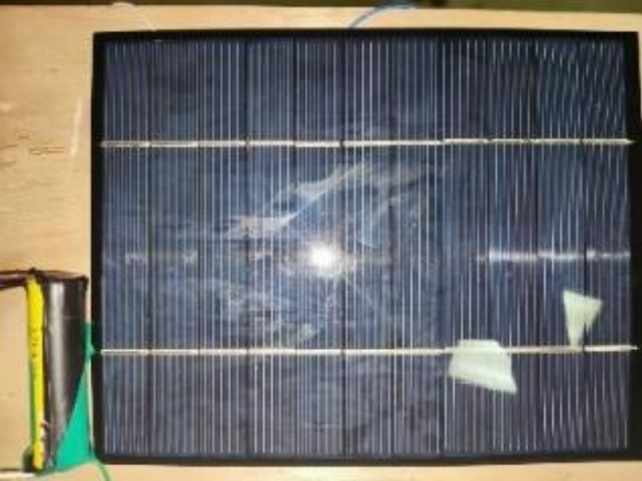
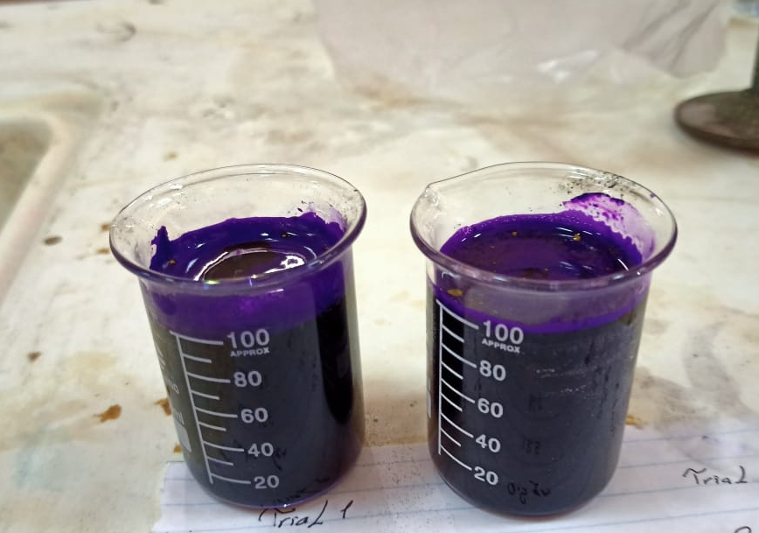
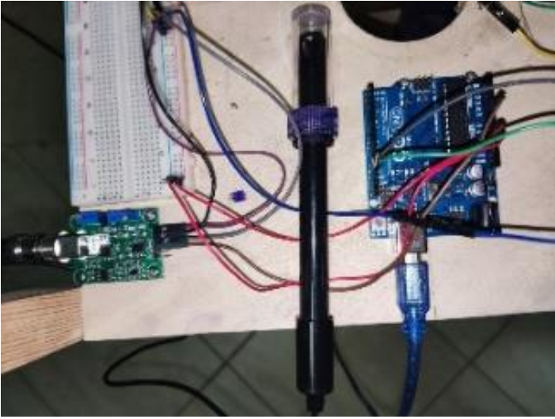
Methods
The Samples of the Laboratory
pH sensor connection
pH sensor & Li-ion battery connection

Slide 12
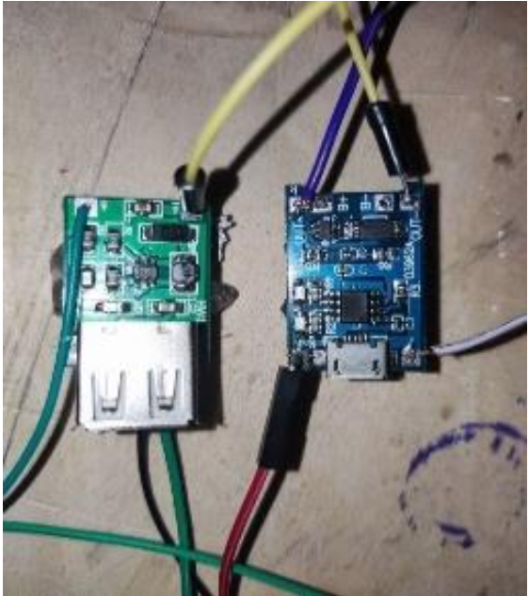
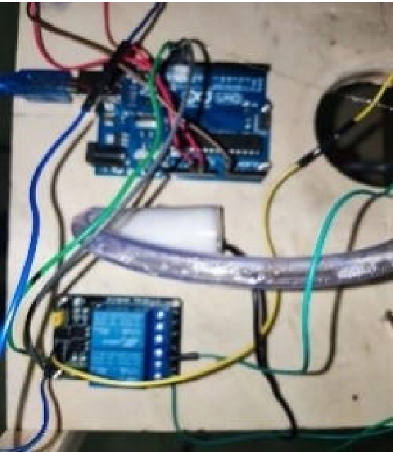
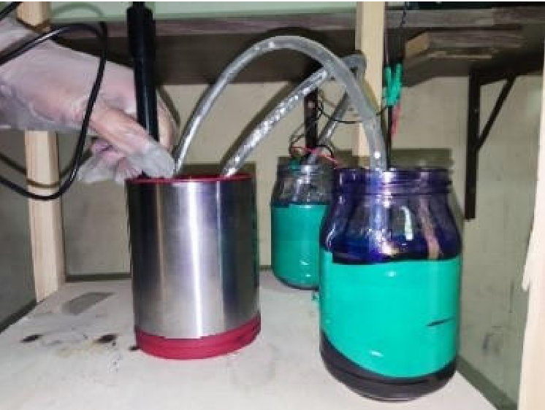
Connection of the transformer
Connection of the pumps & the relay
The pumps connected to the solutions’ container

Slide 13
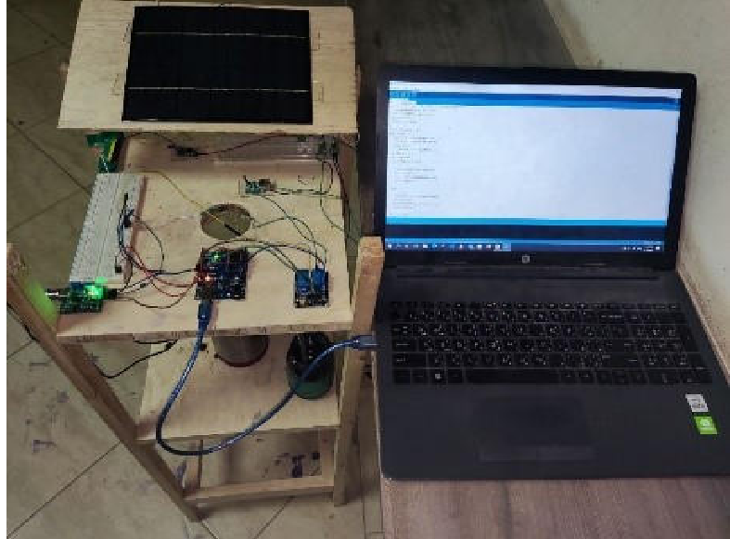

Slide 14
Design Requirements
Ideal pH of 3.4
Efficiency: Time

Slide 15
Negative Results
Burning of the Arduino
Due to
Reverse connection of the wires
Inaccurate results of the pH sensor
Wrong method of calibration
Due to
Solved By
Calibration using Buffer Solutions

Slide 16
Results: Design Requirement 2
Average Time for the trials
3.5 minutes
Efficiency of the protype was measured by comparing the saved time by the project.
Time
Regular Time
Saved Time
3.5 min
6 min
2.5 min
The Increase in Efficiency is 40%

Slide 17
Results
 | Diluted (Trial 1) | Ideal (Trial 2) | Concentrated (Trial 3)
Before Trial 1 | 5.00 ± 0.01 pH | 3.40 ± 0.01 pH | 2.50 ± 0.01 pH
After Trial 1 | 3.60 ± 0.01 pH | 3.40 ± 0.01 pH | 3.30 ± 0.01 pH
Before Trial 2 | 5.50 ± 0.01 pH | 3.40 ± 0.01 pH | 2.20 ± 0.01 pH
After Trial 2 | 3.62 ± 0.01 pH | 3.40 ± 0.01 pH | 3.28 ± 0.01 pH
Average for after trials | 3.61 ± 0.01 pH | 3.40 ± 0.01 pH | 3.29 ± 0.01 pH
Since the pH is always near ideal, the first design requirement was achieved.

Slide 18
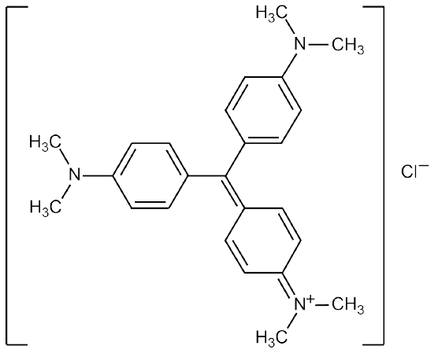
Gentian Violet

Slide 19
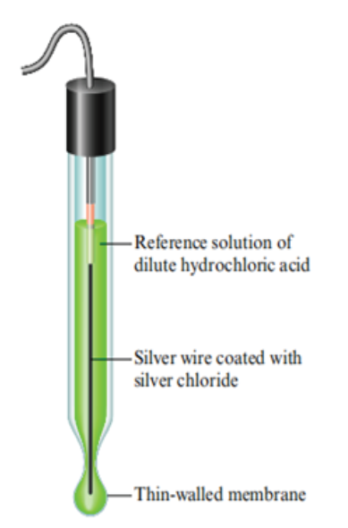
pH electrode
A galvanic cell of a concentration-dependent potential
Standard electrode of known potential
Glass electrode of changing potential
Potentiometer
On dipping the electrode in a solution
Potential changes according to the difference in [H+] concentration

Slide 20
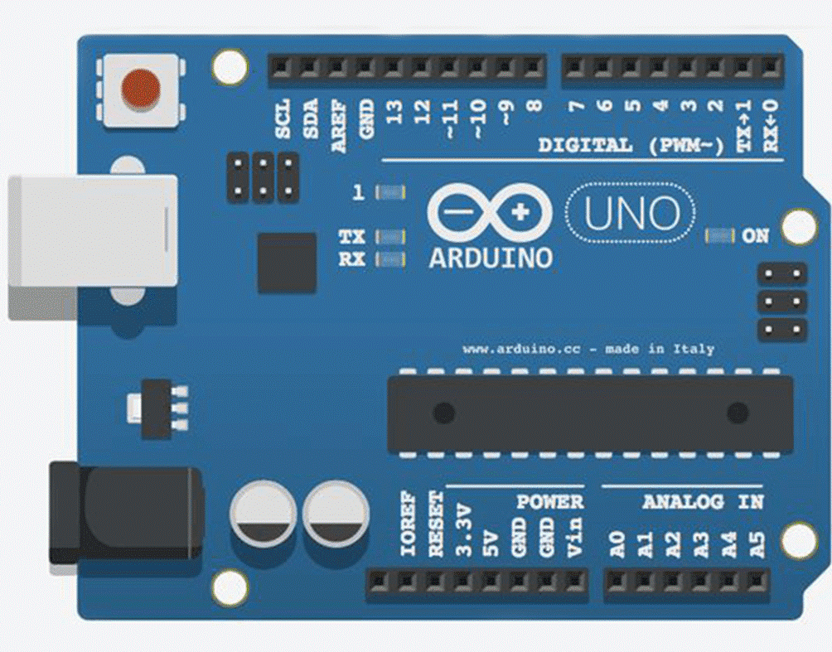
Arduino
Microcontroller
Analog (Input) Pins
Digital Pins
5V Pin

Slide 21
Feedback Control Mechanism

Slide 22
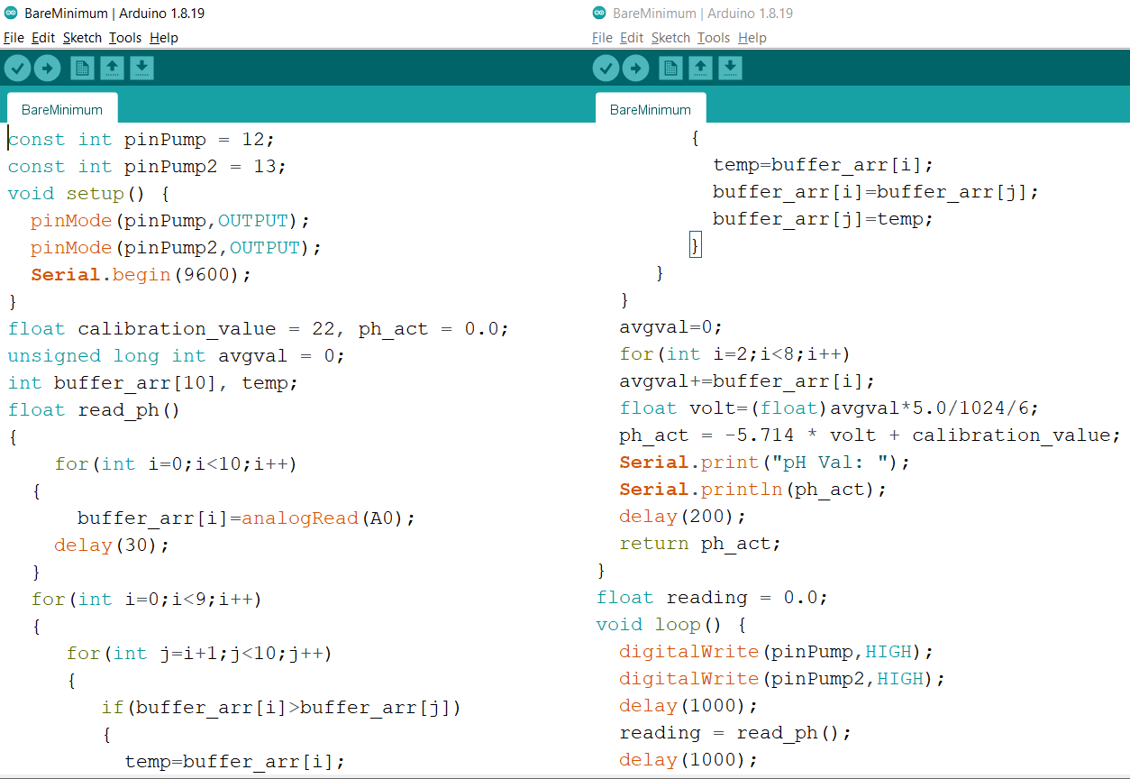
Arduino Code

Slide 23
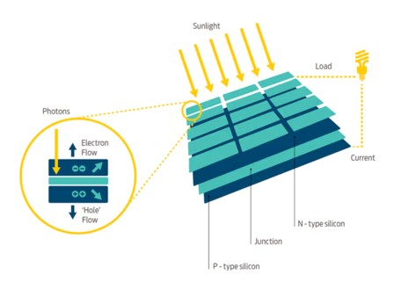
Solar Panels
Light photon strikes the depletion region of the PN-junction
Carries excess charge, creating an electric field
Electrons move to the N region, and holes move to the P region
PN junction works as a small battery that produces external current.

Slide 24
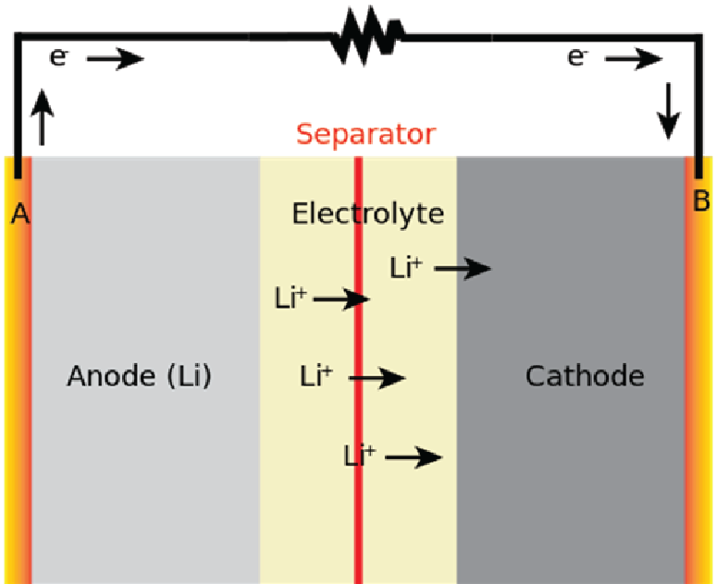
Lithium-ion battery
Consists of
Metallic sheet, containing 3 sheets: anode, cathode, & insulator
Anode
$$LiC_{6(s)} \underset{→}{Oxidation} C_{6(s)}+Li_{(aq.)}^{+}+ e^{−}$$
Cathode
$$CoO_{2(s)}+Li_{(aq.)}^{+}+ e^{−}\underset{→}{Reduction} LiCoO_{2(s)}$$
Total
$CoO_{2(s)}+LiC_{6(s)} \underset{→}{Discharge} LiCoO_{2(s)}$ + $C_{6(s)}$

Slide 25
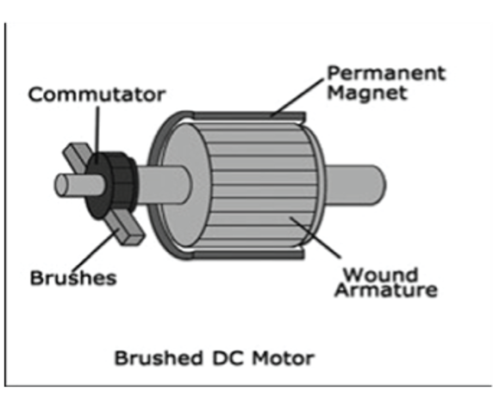

Slide 26
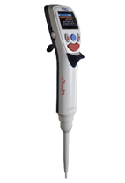
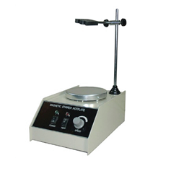
Material Recommendation
400 Dollars
240 Dollars

Slide 27
Benban Solar Park

Slide 28
3.8 TWh
2 tons
60,000 Litres
49 units at a scale of 30
2.9 GWh

Slide 29
THANKS

